Slide 1

2016 Neighborhoods
NOW Conference
Anna M. Gremling
Executive Director
Indianapolis Metropolitan Planning Organization

Slide 2
Notes:
Standard peers: Cincinnati, Cleveland, Columbus, Grand Rapids, Kansas city, Louisville, Milwaukee
Aspirational Peers: Charlotte, Denver, Nashville because they are top performers in Population and Growth

Slide 3
Notes:
Indianapolis Region is growing, but peers are outpacing us.

Slide 4
Freight Exports
Notes:
Mega tons exported by Indy 48
Mega tons exported by our peer 52
Value of our exports are $3M per ton
While Peer Ave is $2.3 per ton

Slide 6
Change in Regional Share of Jobs
2000 to 2013

Slide 7
Percent of Population Growth
2000 to 2013

Slide 8
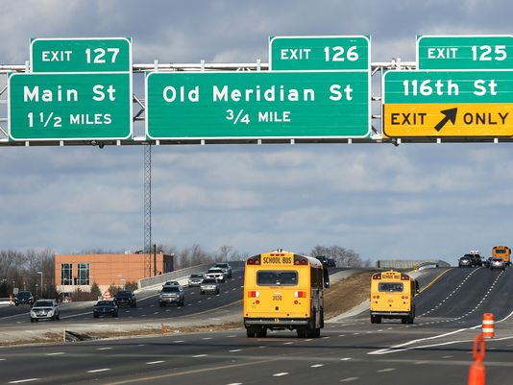
Transportation & Jobs
Transportation for getting people to jobs
  Roads
  Transit
Transportation for goods and services
  Roads
  Rail

Slide 9
Regional
Employment

Slide 11
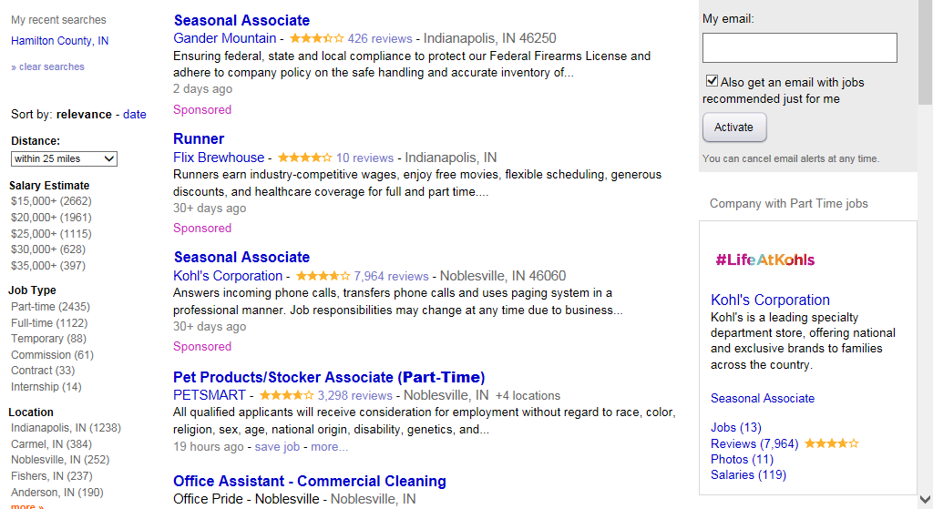
Part Time Jobs in Hamilton County

Slide 12
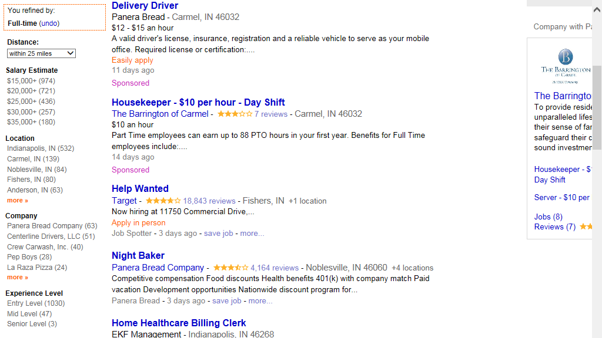
Full Time Jobs in Hamilton County

Slide 13
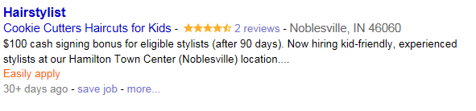

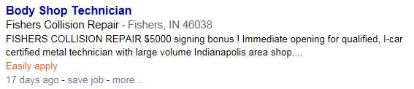
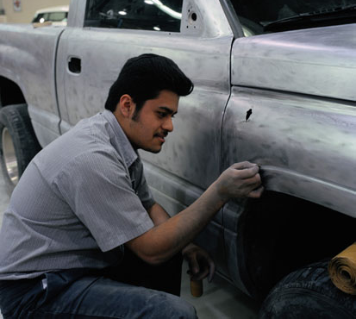
Signing Bonus
Notes:
When you cant find employees there is a high cost of doing business

Slide 14
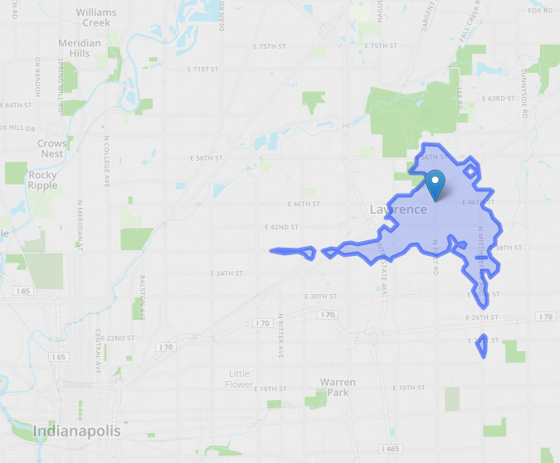
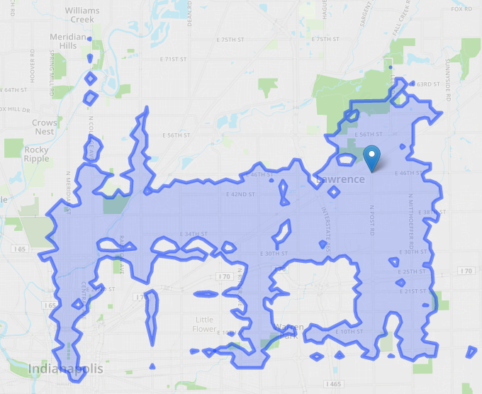
District 5
46th and Post (in Lawrence)
 | Today | Plan | Change
Residents | 8,717 | 47,808 | +448%
Jobs | 8,023 | 109,222 | +1,261%

Slide 15
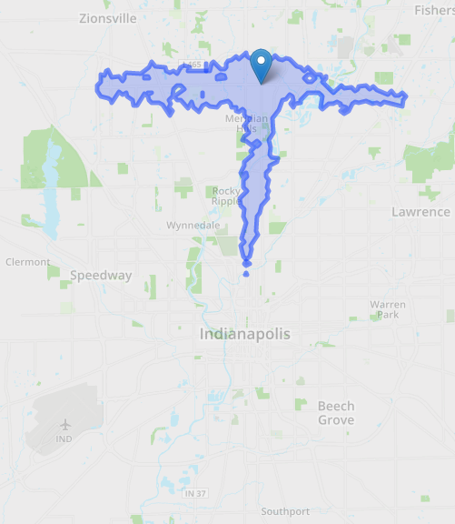
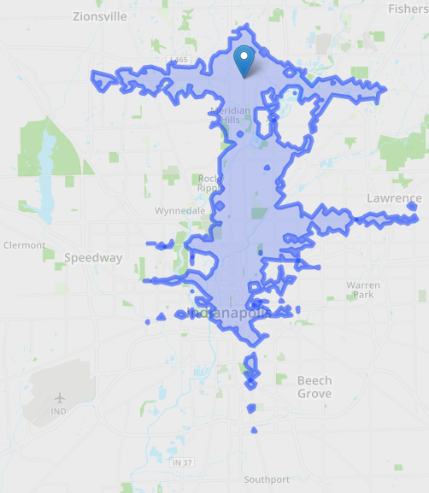
District 2
86th and College
 | Today | Plan | Change
Residents | 31,119 | 67,360 | +116%
Jobs | 67,360 | 249,677 | +271%

Slide 16
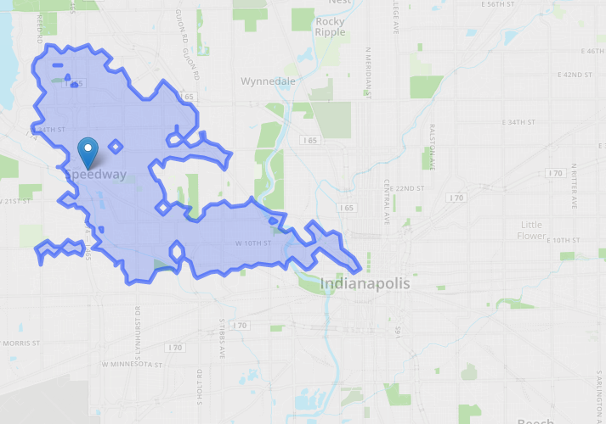
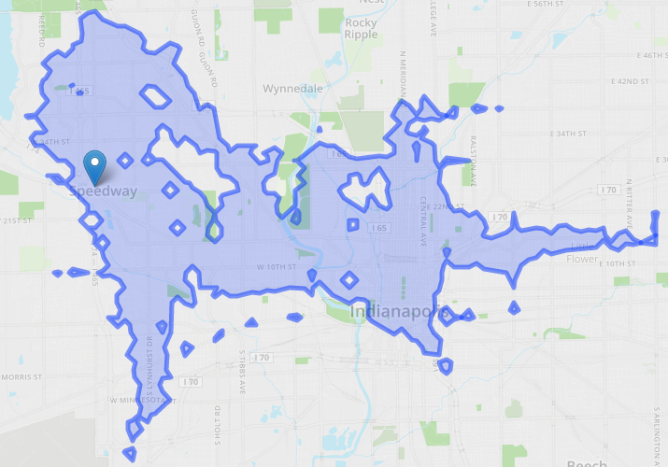
District 6
25th and High School Road (Speedway)
 | Today | Plan | Change
Residents | 27,406 | 50,810 | +85%
Jobs | 69,615 | 157,452 | +126%

Slide 17
Commuter Connect
26 vanpools in Central Indiana helping 243 employees
Seven of the 26 vanpools originate in Hamilton County and carry 69 Hamilton County residents to their places of employment at the Defense Finance and Accounting Services facility in Lawrence, Delphi in Kokomo and various downtown Indianapolis locations.
Three vanpools originate in Marion, Indiana, and carry 21 employees to The Cellular Connection in Carmel.

Slide 18
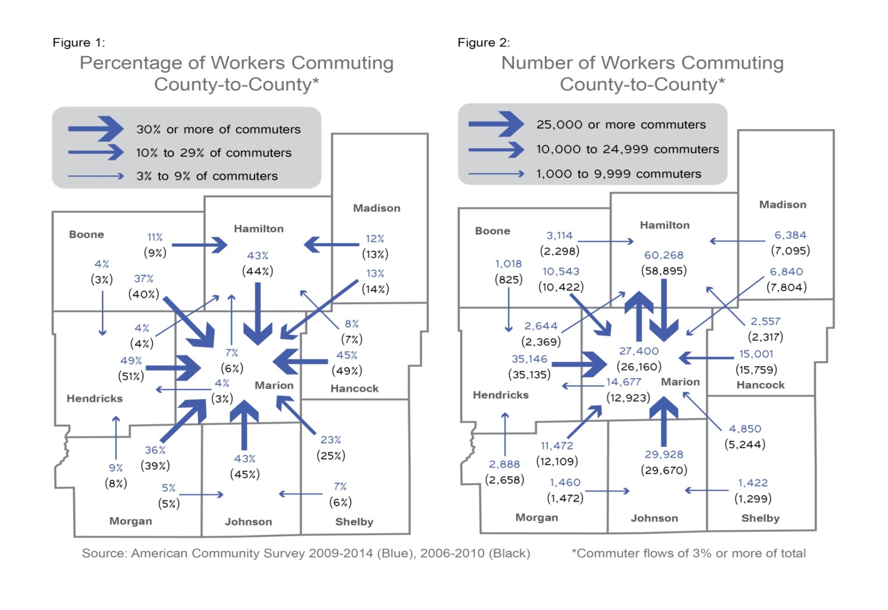
Notes:
County to county commuting patterns

Slide 19
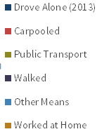
Commuting Mode Share
Marion County
Hamilton County

Slide 21
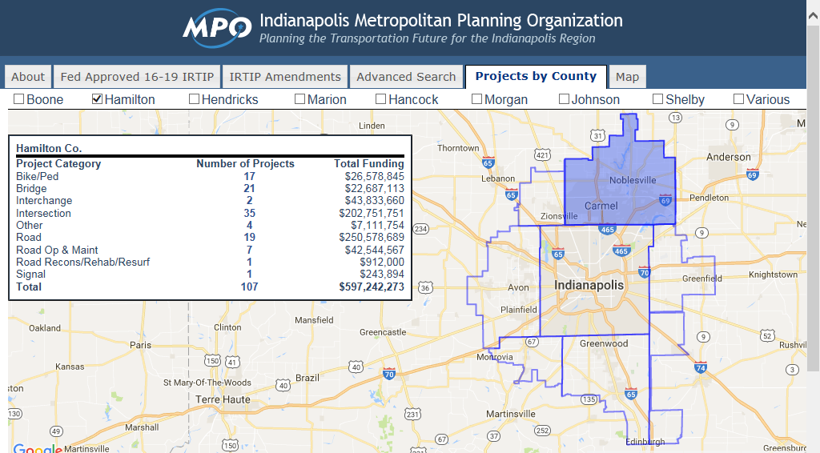

Slide 22
Moving forward
96th and Keystone – Intersection Improvement Planned - Carmel
113th and Florida Street Roundabout – Fishers
126th St and Reynolds Intersection Improvement – Fishers
Lowes Way to Keystone Ramp – series of improvements – Hamilton Co
236th Street East & West – Rehabilitation - Hamilton Co
186th & Cumberland Roundabout – Noblesville
19th & Pleasant St Roundabout – Noblesville

Slide 23
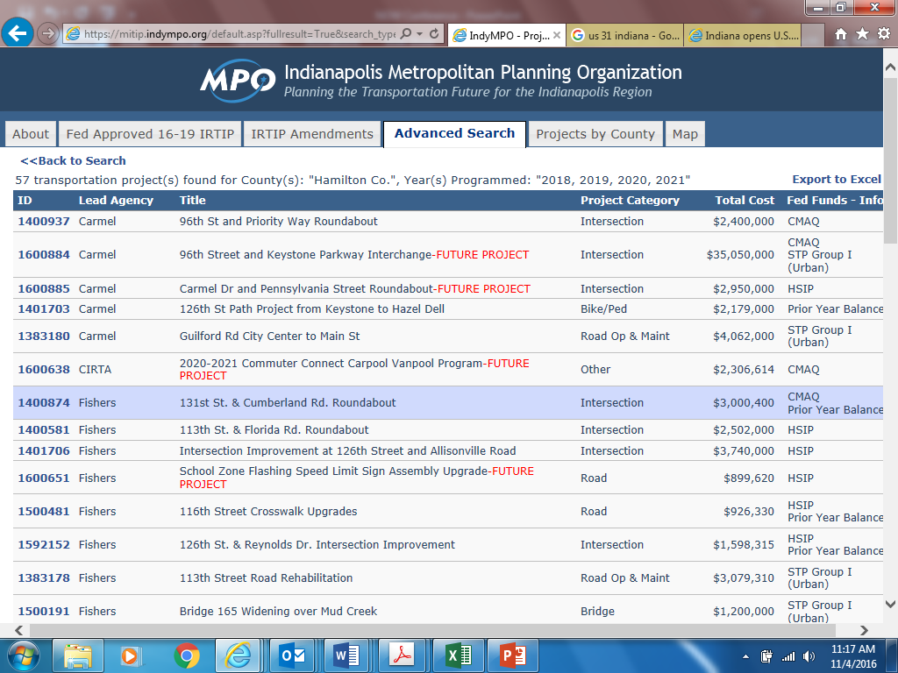
More Information can be found at indympo.org

